Slide 1
LEVERAGING DOMESTIC AUTOMOTIVE SOFTWARE DEVELOPMENT BEST PRACTICES FOR MOSA AND GCIA/VICTORY IMPLEMENTATION
Douglas Priemer, Vice President
Karl Sime, Sr Consulting Engr
Western Labs, LLC
50W Big Beaver Rd Ste 400
Troy, MI 48084
Notes:
I’ve structured this presentation to compare and contrast software development best practices between very different industries. I’d also like the audience to be able to recognize software development skills in the domestic automotive sector that would be extremely useful to meeting or exceeding MOSA and GCIA/VICTORY objectives and goals. The military is mandated to implement MOSA to prevent vendor lock-in and speed up acquisitions, and the domestic automotive industry has already spent billions solving these exact modularity and testing problems via the Software Defined Vehicle (SDV)

Slide 2
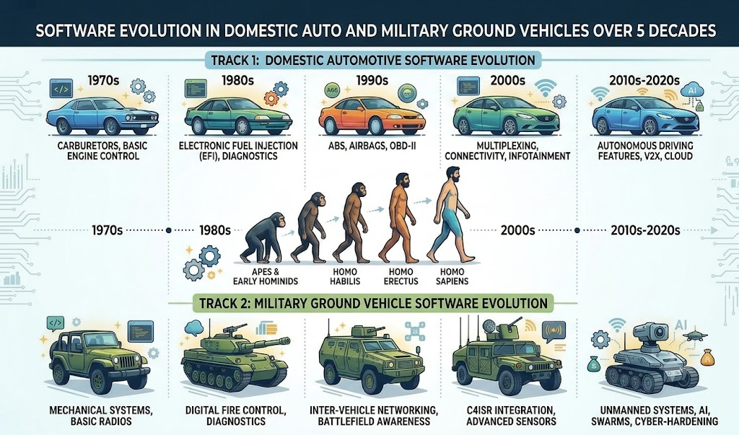
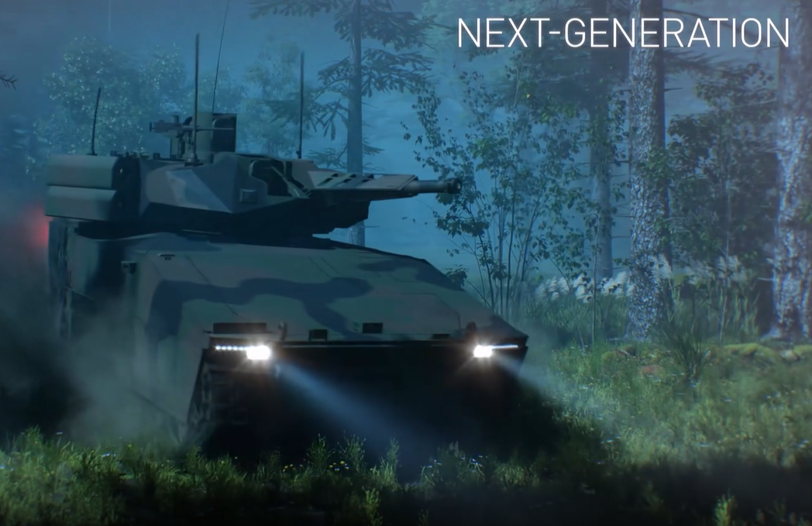
Evolution of Technology – We did this!
Embedded Controls for Propulsion
Systems
We all want to go somewhere and do something
https://teamlynx-xm30.com/
Notes:
Have to mention the XM30 – the crown jewel of MOSA pioneering digital twins as the automotive industry embraces software defined vehicles

Slide 3
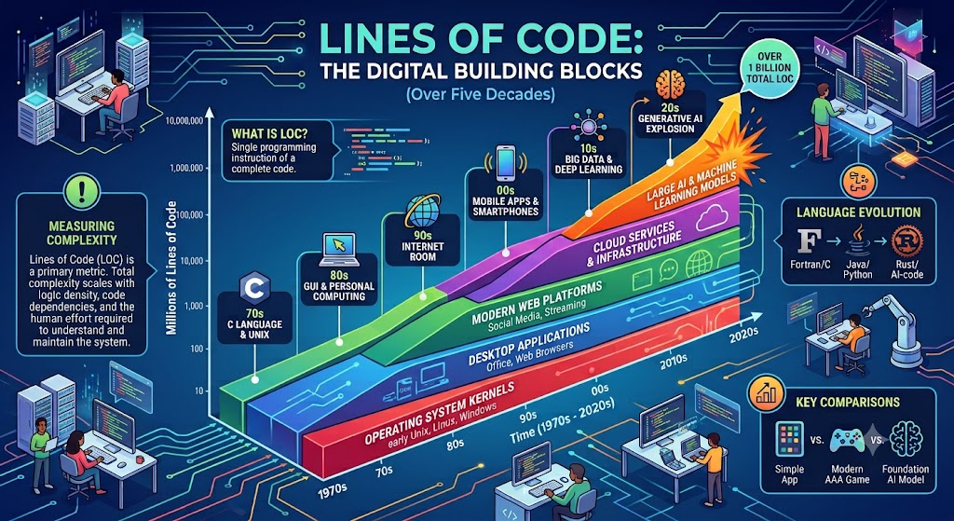
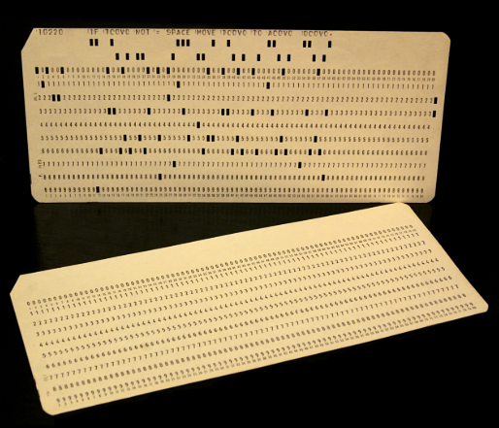
Evolution of Technology – Growing Pains
One Line of Domestic Code
One Line of Military Code
Logic Density in Mil Code much higher
≠
Notes:
A mid 90’s luxury car might have 1,000,000 lines of code but not all of it is Critical. An Abrams M1A2 upgrade might have 500,000 lines of code and it all counts. Today, the same luxury car is about 100,000,000 lines of code while a Military UGV might have 20-30,000,000 lines.

Slide 4
Despite the Evolution – Old Outdated Code Still Exists
Military Challenge – a complex layered mixture of decades old legacy code and cutting-edge modern code, mostly driven by long life cycles
Government Intervention –
FY 1994-2004/2017 – Key Mandates for MOSA
Oct 2020 - DoDi 5000.87 SW Acquisition Pathway (for MOSA)
FY 2021 NDAA – Expand MOSA
May 2021 EO 14028 – Accelerate Commercial Partnerships (ZTA)
Nov 2021 – DoD Software Modernization Strategy Drafted
Feb 2022 – DoD Launches SW Modernization Strategy
March 2025 – Acquisition Reform (SW at Speed and Scale)
Nov 2025 – PAEs Accelerate the use of MOSA
This sparked an in-depth comparison of Tools and Methods used by Automotive and Ground Vehicle for Controls Development and Validation
Notes:
Legacy code is a polite word for stale rotten and broken software. In the 2020’s DoD realized it couldn’t pull it off without help from the outside. My research into “how can we provide our software development and validation services to the Military” turned up some interesting documentation. I interpreted this as an invitation to investigate further. Can the automotive industry contribute to these goals?

Slide 5
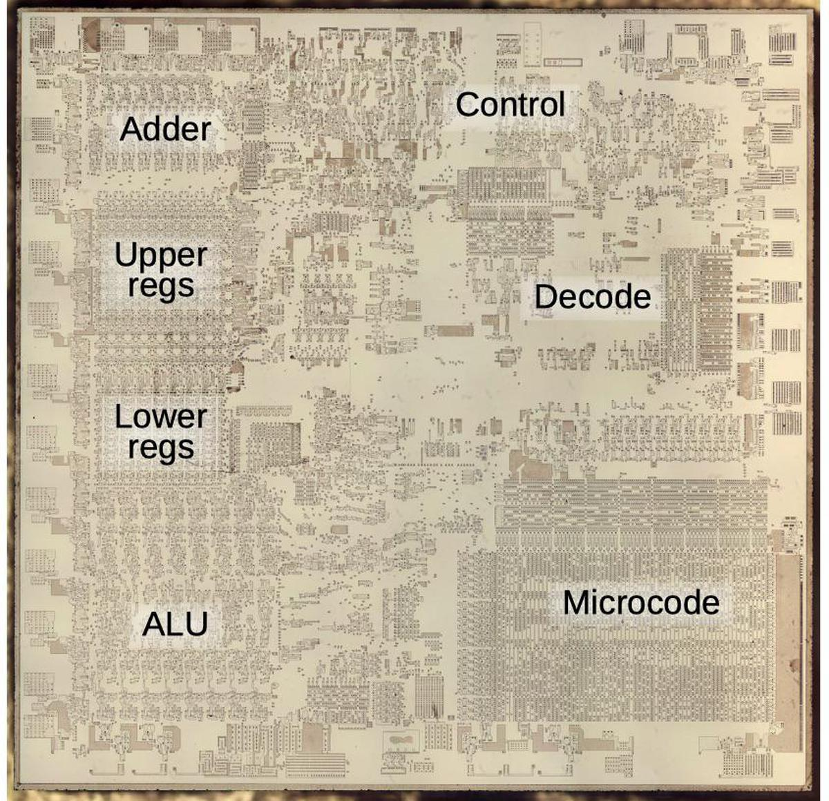
Same but Different . . .
The Military wants modern software. The domestic automotive industry modernizes their software every model year. How can we help?
Let’s start by what we have in common and identify services that directly carry over to the military.
Requirements Engineering and Planning
Risk and Safety Analysis
Architecture and Design
Software Implementation and Coding
Verification and Testing
Lifecycle and Configuration Management
https://ecse324.ece.mcgill.ca/_static/8086-die-blog-post/www.righto.com/2020/06/a-look-at-die-of-8086-processor.html
Notes:
If the domestic automotive business could only modernize software every decade or so we’d be in big trouble. Fortunately, updating software is routine and is enabled by these 6 areas, often described through the V-model. Picture each item as a Venn diagram. Some practices intersect but domestic auto may cover some additional useful practices, same for the military. Potentially both industries can benefit.

Slide 6
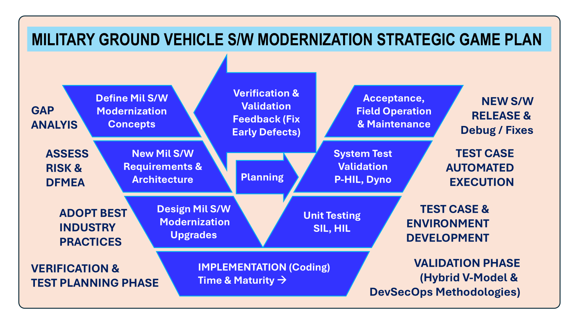
The “V” for DoD – Traceability & Lifecycle Support
V-ECU
Notes:
It is the discipline and thoroughness required by the automotive industry software lifecycle model that facilitates development of new software and yearly security updates. This model works for new software or for software updates, short or very long vehicle controls lifecycles.

Slide 7
GV Architectural Requirements for Embedded Controls
GCIA SysML/UML, IML, MBSE, AGVRA– excel at top-down system specifications. SysML models (Cameo) define what the system should do and where boundaries lie. After that is defined, we need to execute those specifications on embedded microcontrollers or System-on-Chips (SoCs).
Military Software Architects used AUTOSAR ~2020 (AUtomotiveOpenSystemARchitecture) tools to translate SysML-IML port definitions directly into ARXML (AUTOSAR XML) or IDL (Interface Definition Language) files to create hard real-time embedded controls. https://www.3ds.com/products/catia/autosar-builder (Dassault)
GVSC Real Time Control Systems (RTCS) used automotive industry software tools and methods to develop the NeXtECU¹ – a single ECU adaptable to different ground vehicle platforms.
Notes:
Covering the top left of the V. Segways to AUTOSAR.

Slide 8

AUTOSAR IN A NUTSHELL – Layered Software w/ Standardized Abstraction
Classic
Platform
(CP)
Modular SW can be run on different AUTOSAR compliant ECU’s
Hard real-time Deterministic Control
Ideal for Power Electronics, Drive-By-Wire, ABS, Fire Control, Turret Stabilization, APS, Robotic Features
The SW App doesn’t care where the signal came from
https://www.renesas.com/en/products/automotive-products/autosar/autosar-layered-architecture
Notes:
Controls HW suppliers decided not to compete on BSW. Works great for powertrain control, but Compute power is limited and expensive. Problems arose with overly complex wiring harnesses for distributed hard real time controllers.

Slide 9
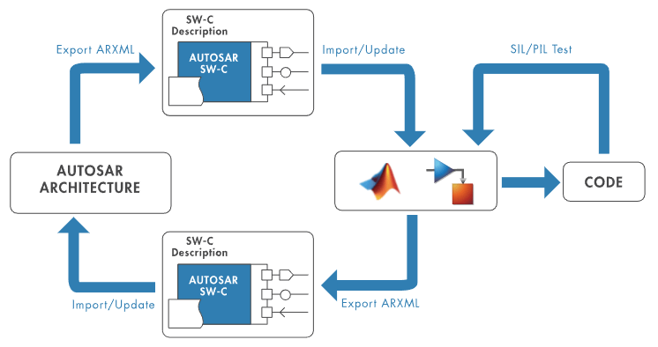
AUTOSAR DEVELOPMENT TOOLS
https://www.mathworks.com/
V-ECU
The Secret Sauce that allow domestic automotive to renew controls yearly . . .
Notes:
The lower right side of the V. SW-Component is our version of a MOSA compliant module. Creates a software development factory greatly speeding up the development process.

Slide 10
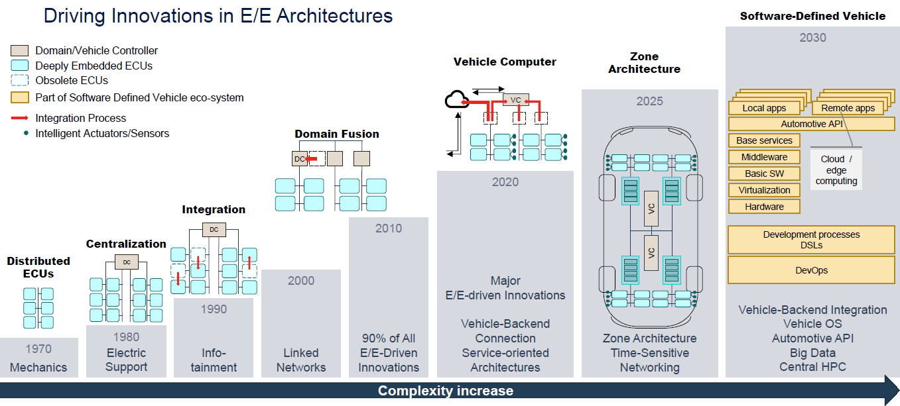
AUTOSAR – Adaptive Platform (AP)
Source: https://www.autosar.org/ click on Latest Release
AP
2017
CP
2003
Notes:
Classic was hard real time whether it is was needed or not. Sounding like a broken record, tech has evolved to levels we need to find way to manage it. AUTOSAR was the answer from automotive industry. Many parallels drawn to MOSA principles.

Slide 11
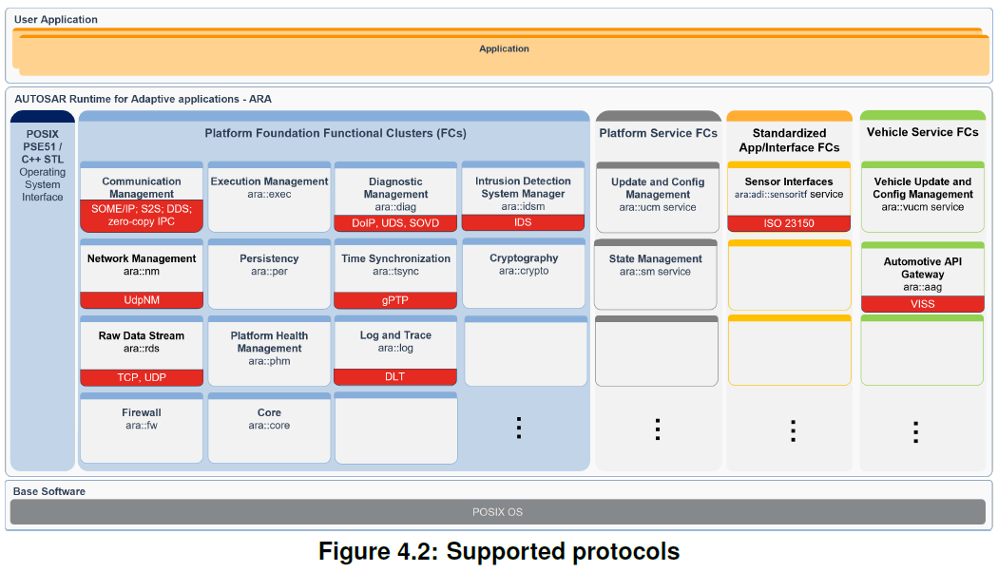
AUTOSAR – AP Architecture (SOA)
Standardized
Internal
Services
Over Ethernet, multiple ECUs
KEY enabler for SW Defined Veh
(SDV)
Abstraction Layer
Virtual Machine (Over HW)
https://www.autosar.org
Notes:
AUTOSAR POSIX OS happens to align with GCIA mandated POSIX compliant APIs in ARINC 653 APEX (APplication/EXecutive) Partitions.

Slide 12
Automotive Ethernet & GCIA/VICTORY
Domain / Layer | Commercial Automotive Ethernet | Equivalent VICTORY / Military Domain | Shared Fundamental Core / Skill
Physical & Transport | 100/1000BASE-T1, Automotive Switches | VICTORY Data Bus (VDB), Shared Processing Units | Packet-level socket I/O, VLAN tagging
Timing & Sync | IEEE 802.1AS (gPTP) / TSN | IEEE 1588 PTP / Time Service | Microsecond clock synchronization
Middleware Architecture | SOME/IP, DDS, AUTOSAR Adaptive | VICTORY Shared Services / Component Types | Service-Oriented Architecture (SOA)
Diagnostics & Health | DoIP / UDS over IP | VICTORY Management & Health Services | Telemetry, fault-logging & health monitoring
Notes:
This corresponds to Section 4 in the whitepaper. Both MIL and auto have realized comms is the key to enabling SDV and what drove AUTOSAR Advanced Platform.

Slide 13
ISO/SAE 21434 to Enhance VICTORY Security Architecture (VSA)
VSA defines domain boundaries. ISO/SAE 21434 provides the technical implementation rules to enforce those boundaries at the chip and code level.
Hardware-Rooted Chain of Trust: ISO/SAE 21434 (aligned with SAE J3101) mandates that firmware integrity be anchored in immutable hardware (such as a Hardware Security Module / HSM or Secure Element). Applying this ensures that no node on the VICTORY bus can boot compromised firmware or forge network identities.
Freedom From Interference (FFI) for Security: ISO/SAE 21434 enforces spatial, temporal, and communication isolation rules. This guarantees that if a non-critical VICTORY service (e.g., a crew display widget) is exploited, memory protection units (MPUs) and encrypted bus protocols prevent the breach from leaking into safety-critical drive-by-wire or active protection channels.
Threat Analysis and Risk Assessment (TARA) – core engineering phase of ISO/SAE 21434 addressing software cybersecurity.
Notes:
boundaries (such as Unclassified vs. Classified enclaves, or Tactical vs. Vehicle Control domains). When it comes to security, more is better, and seen through different eyes.

Slide 14
MOSA and ASPICE
Module Centered Frameworks
MOSA Requirement: Systems must be partitioned into cohesive, loosely coupled, and severable and interoperable modules that encapsulate internal logic and hide implementation details.
ASPICE (Automotive Software Process Improvement & Capability DEterminanation) Complement: a SW engineering discipline, mandates strict decomposition of software components into static and dynamic views. It enforces bidirectional traceability between software requirements and architectural software components, ensuring modules maintain high cohesion without undocumented dependencies. https://vda-qmc.de/en/automotive-spice/

Slide 15
ISO-26262 & ISTQB for MIL-STD882E
Risk & Functional Safety Testing
MIL-STD-882E is a top-down, high level, system-level standard. It excels at broad hazard identification, operational safety, and risk assessment matrices.
ISO 26262 Complement is a bottom-up, highly prescriptive functional safety framework. It focuses specifically on Electrical, Electronic, and Programmable Electronic (E/E) systems, dictating strict engineering rules for software architecture, hardware metrics, and fault isolation. Hazard Analysis and Risk Assessment (HARA) is a main component of ISO 26262 functional safety.
ISTQB (International Software Testing Qualifications Board) Complement: Component & Unit Testing: ISTQB methodologies utilize test isolation techniques (stubs, mock objects, and test drivers). This allows verification engineers to test a severable module in a "sandbox" environment to prove its functionality before integrating it into the broader platform. https://istqb.org/
Notes:
Once the architecture + Comms are laid out and all tasks are defined, let’s discuss functional safety – how to execute those tasks safely. Together, the standards complement each other in a powerful way

Slide 16
SW Validation & Verification
https://www.mathworks.com/
HIL
SW PATCHES
ISO 26262
ISO/SAE 21434
ISTQB
Notes:
The lower right side of the V. The ability to share and reuse high fidelity plant models is paramount to continuously modernize military GV software.

Slide 17
Conclusion:
We hope this presentation provides a framework of the domestic automotive software engineer skills that complement all the components of MOSA in a way that provides a conduit to more effective acquisition with the DoD in the area of MOSA certified ground vehicle software.
The intention is not to replace Military standards and best practices but rather to identify critical civilian software development skills in the domestic pool of engineers available to support military related software modernization initiatives.
We recommend a Cross-Industry Community of Interest (COI) to bridge the gap between Detroit automotive software architects and the Army's ground vehicle systems engineers to establish strategic value for MOSA initiatives and goals.

Slide 18
Contact Information
Douglas Priemer, Vice President
Karl Sime, Sr Consulting Engr
Western Labs, LLC
50W Big Beaver Rd Ste 400
Troy, MI 48084
https://westernlabs.com/
Phone: +1 (313) 306-5907
Email: operations@westernlabs.com
GVSC Real Time Control Systems (RTCS) NeXtECU Reference:
1. M. Sprengel, S. Raman, J. Rogers, P. Kruchko, D. Pace, “Hardware-in-the-Loop Plant Modeling in Support of the US Army’s Common Powertrain Controller Development”, In Proceedings of the Ground Vehicle Systems Engineering and Technology Symposium (GVSETS), NDIA, Novi, MI, Aug. 11-13, 2020.

Slide 19
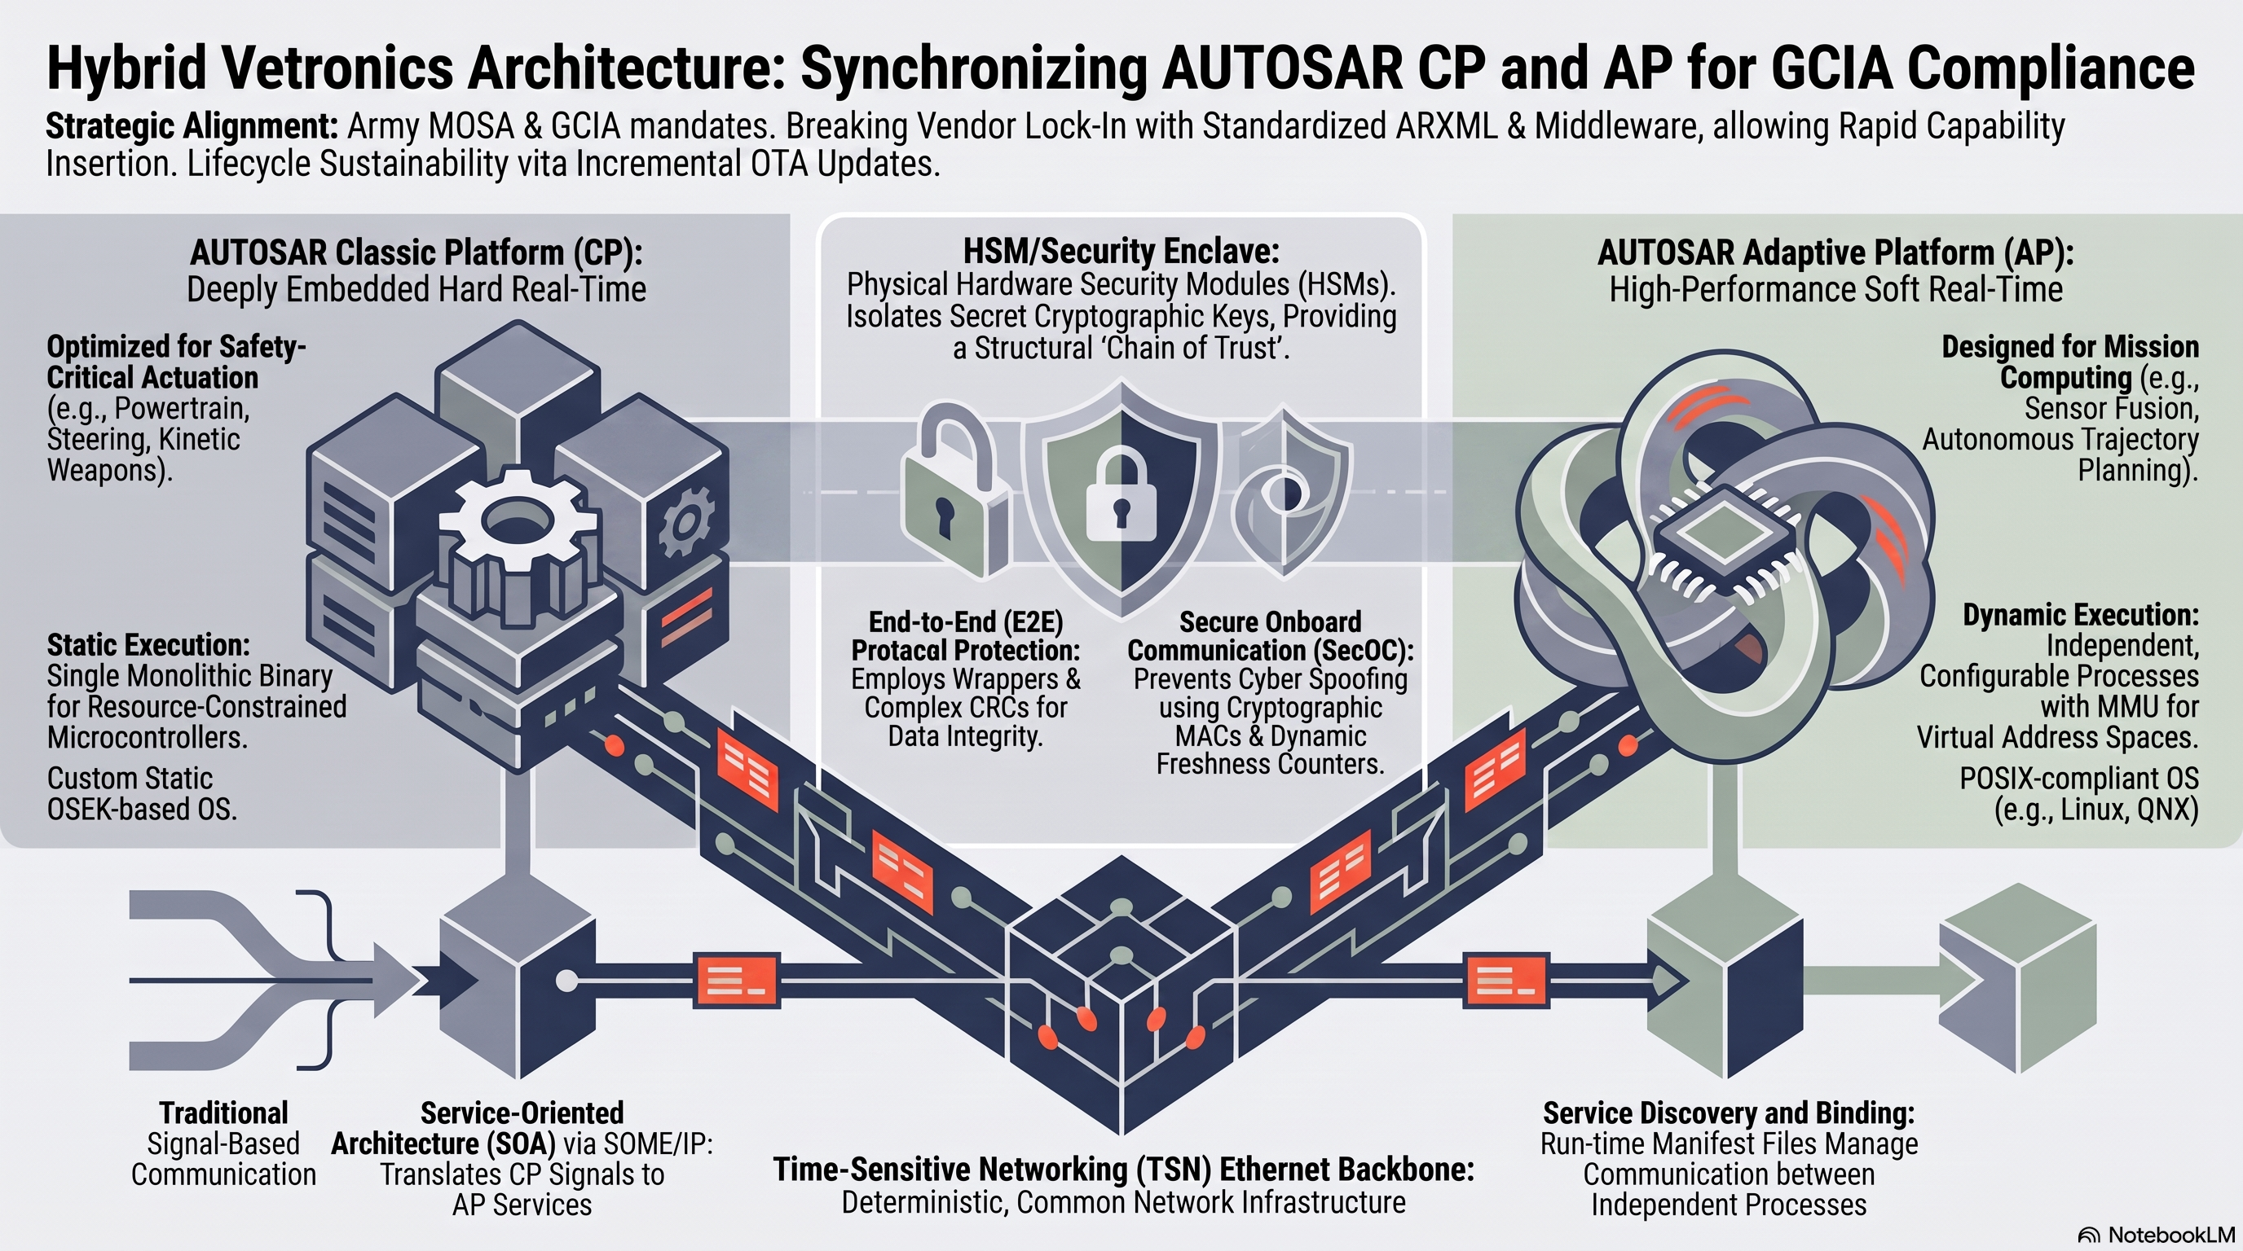
Supplemental (AUTOSAR example)

